Slide 1


The Webinar Will Begin Soon at 7pm CT
Notes:
You will receive a follow up email after the webinar with links and resources
We know you can’t mute/unmute etc.

Slide 2
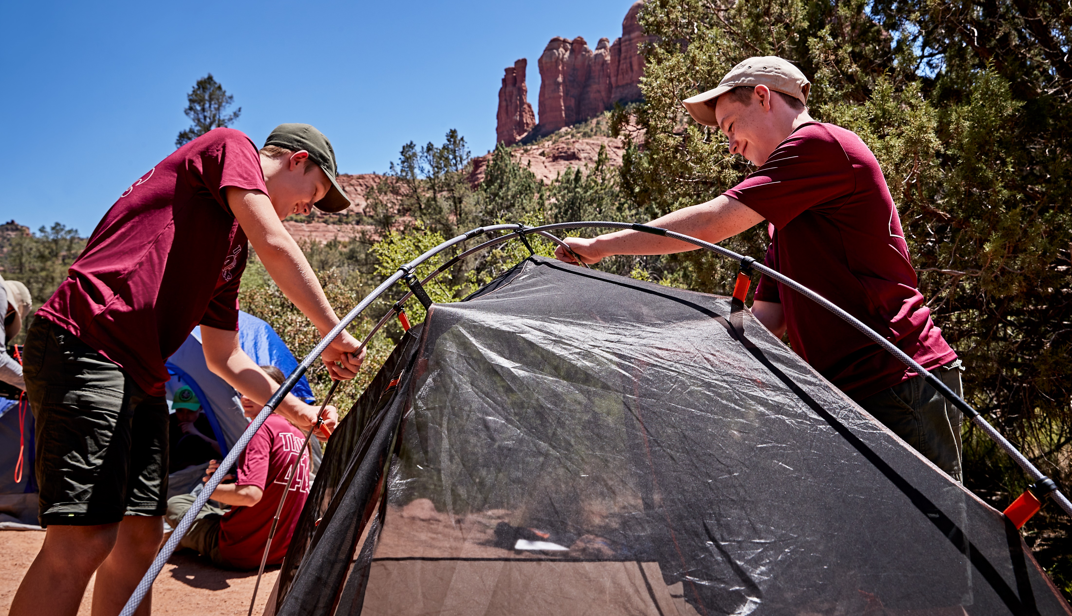
Implementing the Short-Term Camp
NCAP Classification
Notes:
Frank then turn to Tom
Thank you for joining us!
Developed over last 18 months
Thoughtful approach by many committees in collaboration to create a classification that made sense and reflected what councils are doing
Text heavy presentation – BUT this is not a full-blown training – you will learn more about that later in the presentation
We will review the agenda shortly, so please try to hold questions till toward the end because it is likely we will answer many questions you have as we move through the material
Highlight some of this may be new to you who have never worked with NCAP – new terms, processes etc. Reach out to your local council NCAP chairman, if you don’t know who that is, reach out to your Scout Exec and or reach out to ncap@Scouting.org and we will connect you with resources.
Thank you for attending, thank you for ensuring your council is prepared to successfully roll out short-term camps in your council.

Slide 3
Tonight’s Panel
Eric Hiser, National Camp Accreditation Program Standards Chair
Paula Boothe, Western Region Outdoor Ethics Coordinator
Andrea Watson, Director – Outdoor Programs and Properties
Notes:
Frank intros
Intro Carl last then turn to him
Frank introduce Carl
Since 2013, Councils have been using the NCAP process to look at their camps and make certain that they are delivering the promise of having high quality outdoor experience to our youth
We are blessed to have a phenomenal group of leaders guiding the process
Carl Nicolaysen is the chairman of the NCAP Committee, he has been a member since it's inception.

Slide 4

Eric Hiser
NCAP National Standards Chair
Notes:
Frank introduce Carl
Since 2013, Councils have been using the NCAP process to look at their camps and make certain that they are delivering the promise of having high quality outdoor experience to our youth
We are blessed to have a phenomenal group of leaders guiding the process
Carl Nicolaysen is the chairman of the NCAP Committee, he has been a member since it's inception.
Carl -
Welcome and thank you for joining us tonight. Short-term camping events have been a big part of all of our council's programs from the beginning of Scouting.
The NCAP process has shown councils that we have to constantly look at our camps and programs and make certain that they are safe, relevant, and what is wanted and needed for our youth.
All our councils have short term programs (1-3 day events) and now with todays challenges, we need to make certain that all our camps are safe and fun for everyone involved.
Short-term camping has been one area that has needed our attention for a while, and we are excited to have the Outdoor Programs Team help explain this new classification.
Thank you for being on todays webinar, and thank you for wanting to help your council deliver our promise to the youth
<<< Eric Hiser >>>>
Frank turn to Richard

Slide 5
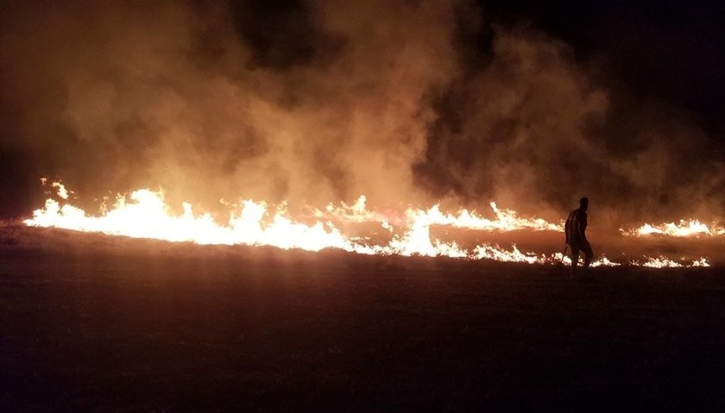
Safety Moment - 12:20 a.m.
Safety Moment – At 12:20 a.m.
Notes:
Richard (Then turn to Frank)
Any safety moment or incident report that starts as something happened at 12:20 am is probably not going to be positive (nothing good happens after XX). In this case we have a typical district camporee.
One report of the incident:
This weekend at our camporee a scout from a troop decided to get out of his tent after lights out and play flamethrower with pam and a lighter. The pam caught on fire, kid panicked and tossed the can into the field and set the camp on fire. Fire department camp out and put the fire out, nobody was hurt, and no structures were touched.
We could stop our safety moment here, discuss that perhaps we just hold the Scout responsible and move on. However,
The other report of the incident was a near miss: A fire started around 12:20 in the morning in the field behind where all the tents were set up. The campsites were quickly evacuated, and participants were moved to the pavilion away from the fire and smoke. The fire departments were called. They arrived, extinguished the fire. There were no damage to tents or buildings on the property.
Lesson learned was - You should have one adult volunteer contact authorities while the others make sure everyone is safe and away from danger. Make sure the authorities are able to access the property easier. No context on that statement, leads to more questions.
Two interesting facts to share. The first report I went over was clear as to what happened, it also included photos (these are the photos) The second recorded only as a near miss, with no details how the fire started. Guess what, the first report and photos came from a volunteer, posting to a scouting oriented form, the second came from the council.
As I’m sure you all are aware, one of the Churchill projects around keeping young people safe involves incident reporting and sharing more information. The challenge illustrated here is potential data quality and interpretation issues. We need quality input to give quality output. And now the rest of the story. (slide)

Slide 6
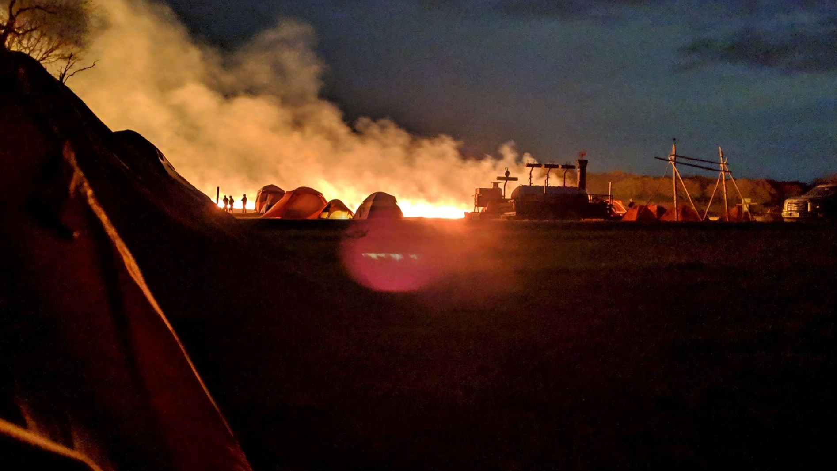
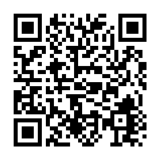
It could have been much worse
Notes:
Remember the lesson learned about better response and facilitating emergency response? This was another perspective of the fire. What do you all think could have happened if the wind was blowing toward those tents at 12:20 am?
So please if an incident occurs, gather the facts and give us clear, concise and most importantly complete details so we can help make scouting safer.
Hit that QR code to go to the incident review page on Scouting Safely to see how great reporting can help the movement move forward.
TURN TO FRANK

Slide 7
Today’s Agenda
Why Short-Term Camp?
What is Short-Term Camp?
Training Requirements
NCAP Standards Overview
Common Outdoor Ethics Scenarios
Q&A
Notes:
Frank
Scenarios throughout the presentation will address many of your questions

Slide 8
Why Short-Term Camp?
Ensure the quality and safety of all district and council organized overnight activities.
Previously no BSA standards (other than the Guide to Safe Scouting) have applied to district and council events not considered a “resident or family camp”.
Only some weekend events were required to follow NCAP quality and safety standards.
Notes:
Frank then turn to Richard
Acknowledge - change is hard
In many cases you are already doing much of what is being required. Many items are not actual change in policy.
New paperwork to track / develop
Worked hard to think through applicability, ease the burden

Slide 9
Why Short-Term Camp?
Many liability and accident-sickness claims have been the result of district and council events.
  A few recent examples include:
    Adult leader collapses from chronic medical issues
    Golf Cart and Utility Transport Vehicle accidents
    Unsupervised and age-inappropriate activities for youth
    Jousting, spear throwing and pumpkin chunking (prohibited activities)
    Shooting Sports related issues
    Homemade zip lines
    Excessive injuries and claims
Notes:
Richard then turn to Brian
In addition, lots of brand risk with social media posts of these events. Also numerous medical events during short term camp.
These are all within recent history
These are just examples and there is a real risk in these events
Discuss don't print maybe something about Golf Carts rented by volunteers without council knowledge, UTV's operated at excessive speed or with inadequate training.
We have youth who have had everything from TBI to severed finger and as in the safety moment numerous potentially tragic near misses.
And homemade zip line injuries at camporees / Scout shows have resulted in substantial economic losses.

Slide 10
Short-Term Camp Definition
A short-term camp is any council-organized overnight camping program, whether one-time or continuing, that is one, two or three nights in length where the council or its agents provide the staffing and program and may provide food services, and includes camps conducted off council properties. National training courses are subject to the short-term camp requirements,
regardless of format or duration.
Notes:
Brian
Here is the definition of what a Short-term camp is- read the definition
The two key parts of the definition are:
1, 2, or 3 nights
Council organized
Staffing
Provides program
Food Service
The definition of Council is:
Council
Districts
Order of the Arrow – lodge or chapter
Venturing Officers Association
Any organization of the council

Slide 11
Short-Term Camp vs Long-Term Camp
How is “short-term” camp different from “long-term” camp?
Long-term camp is for any council organized overnight program that is 4 or more nights.
(for our purposes, National is a council too)
Notes:
Brian
Lets talk about the difference between a Short-term camp and a long-term camp
It’s the length of nights involved
If it is one, two, or three nights – it is a short-term camp
If it is four nights or more – it is a long-term camp
If you have a camp that has more than 1 session that is back to back or a day apart and when adding up the total nights it is 4 or more – it is a long term camp

Slide 12
Overnight
1-3 nights
4 or more nights
Unit operated
Council operated program, staff or food
Unit operated
Council operated program, staff or food?
Follow the Program Materials and Guide to Safe Scouting
This is a long-term camp
This is a short-term camp
Follow the Program Materials and Guide to Safe Scouting
Notes:
Here is a decision tree that helps clarify just what the camp is
First of all – is it an overnight camp, or is it a day camp or day event
How many nights are involved – is it 1, 2 or 3 nights? Then you have to ask – is it a council run camp or a unit operated camp
if it is a unit operated camp – they follow the program materials and the Guide to safe Scouting, or if it is a council operated camp – then it is a Short-term camp and you follow the NCAP Standards
Or, if it is a 4 or more-night camp, then is it a council operated program, or a unit operated program
Then again – if it is a council run camp – then it is a long-term camp so you follow the standards, if it is a unit operated camp – they follow the program materials and the Guide to safe Scouting

Slide 13
What type of camps will fall under this classification?
Put simply, all council, district coordinated overnight events that are three nights or less.
This includes district camporees, council camporees, Cub Scout/Webelos Family Camps, Order of the Arrow events, training events like NYLT, Woodbadge and more.
Leave No Trace Master Educator and Trainer courses including an overnight or two nights! (Master Educator courses will be included as a National training course in NCAP Circular No. 15).
Notes:
So just to clarify
If it is organized by the council and it is has an element of one, two or three overnights nights to it – it is a short-term camp
Examples are:
Council camporees
District camporees
Family camps
Order of the Arrow ordeals
Conclaves
Because of the nature of Woodbadge courses, NYLT courses where they have a set training schedule – no matter if it is a 2 weekend course or week long – they are falling under Short-term camps
Tom – can you give them a bit more information on this

Slide 14
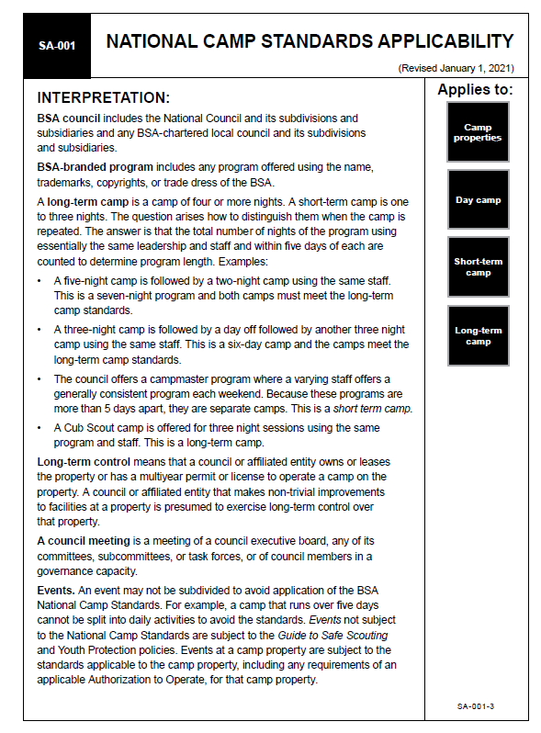
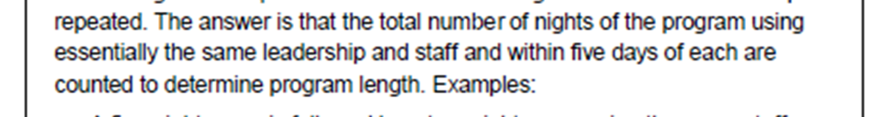
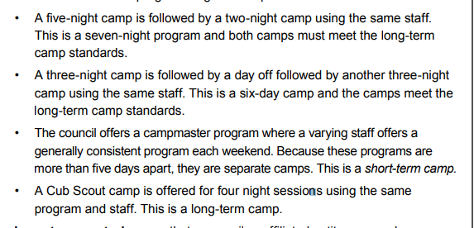
Notes:
Tom
Let’s look at the interpretation of the definition and a few scenarios
What does it mean to be a continuing short-term camp?
Discuss the four scenarios BRIEFLY.
The answer is that the total number of nights of the program using
essentially the same leadership and staff and within five days of each are
counted to determine program length. Examples:
• A five-night camp is followed by a two-night camp using the same staff.
This is a seven-night program and both camps must meet the long-term
camp standards.
• A three-night camp is followed by a day off followed by another three night
camp using the same staff. This is a six-day camp, and the camps meet the
long-term camp standards.
• The council offers a campmaster program where a varying staff offers a
generally consistent program each weekend. Because these programs are
more than 5 days apart, they are separate camps. This is a short-term camp.
• A Cub Scout camp is offered for four-night sessions using the same
program and staff. This is a long-term camp.

Slide 15
Short-Term Camp Administrator
This person is responsible for ensuring that the planned camp complies with the NCAP Short-term Camp Standards. This means walking the property to ensure that it is appropriate for the event; ensuring that paperwork is filed and any written BSA approvals are completed and obtained through the council; confirms facilities and program are safe and in good order before starting operation; and that appropriate health, safety and sanitation provisions are made. This individual also ensures that all activities at the short-term camp comply with the applicable BSA National Camp Standards.
Pre-Qualifications: The short-term camp administrator must be a registered Scouter who holds either a current NCAP short-term camp administrator certification issued by the BSA or holds a resident camp director certificate from BSA National Camping School. Refer to NCAP Standard SQ-403.
Notes:
Tom
New position
Person is responsible for the administration of the camp
Follows appropriate NCAP standards
Helps to approve the site for the camp
Files the paperwork required in NCAP
One is needed for each short-term camp
Council may decide how to manage this person/people
One for each camp
One for the district
One for the council
Currently certified Resident camp director can also serve in this role.

Slide 16
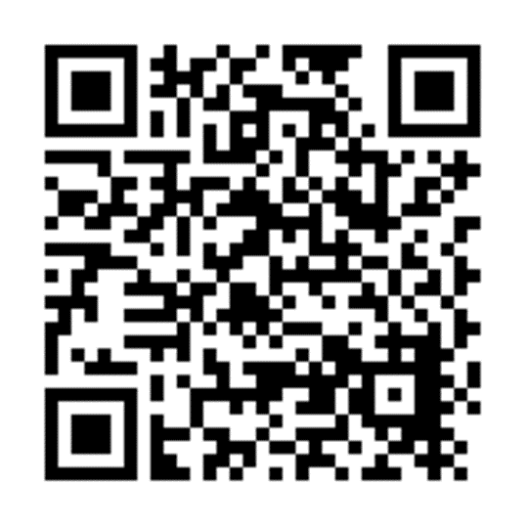
Short-Term Camp & National Camping School
Councils can host the national camping school required “Short-term Camp Administrator” training program, or their volunteers can take it online via the Outdoor Programs team.
Training will begin being offered on 10/15/2020 to prepare for 1/1/2021 events. The training is approx. 9 hours.
Watch for your council or other local councils to host this training or encourage your council to host if it hasn't already signed up to do so!
Notes:
Tom (to Andrea)
We have enabled councils to apply for and host the training. Register at the short-term camp website
Highlight ability to have a resident camp director serve as the short-term camp administrator
Schedule of national council short term camp online courses can be found at the short-term camp website
Course designed for about 9 hours and allows for the council to add council specific information

Slide 17
Will every council have to be authorized to host short-term camps?
Yes, all councils who currently have an approved Authorization to Operate on file are automatically granted the ability to locally authorize short-term camps.
Councils who do not have a current NCAP authorization will work with the NCAP national committee to be able to authorize short-term camps.
Notes:
Andrea
The National NCAP Sub-Committee and the outdoor programs department have worked hard to ease the perceived burden of the NCAP process.
All councils currently authorized to run programs will automatically be able to run short-term camps at the start of 2021.
If you don't have a NCAP Authorization because you do not operate a Long-term camp, reach out to your region NCAP Chairman to make certain that you get an authorization to run these programs

Slide 18
Short-Term Camp NCAP Process
Pre-Camp
On-Site Declaration
On-Site Documentation
Post-Camp
NCAP Council Review
Notes:
Andrea
Let’s review the short-term camp implementation process in depth.
Here is a workflow chart we will review in greater detail.

Slide 19
Short-Term Camp NCAP Process
Pre-Camp
On-Site Declaration
On-Site Documentation
Post-Camp
NCAP Council Review
The site of the short-term camp is reviewed. If not on a BSA accredited camp property, the “NCAP site appraisal form” is used and submitted to the council.
The short-term camp administrator files the “NCAP Local Council Authorization and Declaration” form with the council. It is signed by the Scout Executive and NCAP chair or their approved designee.
The camp is planned in accordance with the NCAP standards, including the required plans.
Notes:
Andrea
Like day camp and long-term camps, many parts of the NCAP process begin before camp begins.
This includes the local council authorizing the event to take place.
The Site appraisal form – explain why/when.

Slide 20
Short-Term Camp NCAP Process
Pre-Camp
On-Site Declaration “Assessment”
On-Site Documentation
Post-Camp
NCAP Council Review
On-site, the NCS certified Short-Term Camp Administrator reviews preparations and assesses the camp to ensure compliance as an “assessment”.
The NCS certified Short-Term Camp Administrator signs the assessment declaration portion of the “NCAP Local Council Authorization and Declaration” form.
Notes:
Andrea
When short-term camp administrators arrive at short-term camp, they will work with camp leadership to review the standards implantation on site and sign off the “assessment declaration” portion of the “NCAP Local Council Authorization and Declaration”
Form is filed with local council.
STRESS THAT THE ASSESSMENT IS NOT LIKE OTHER ASSESSMENTS AND DOES NOT INCLUDE AN NCAP TEAM – TP wrote this. This has been a confusion.

Slide 21
Short-Term Camp NCAP Process
Pre-Camp
On-Site Declaration
On-Site Documentation
Post-Camp
NCAP Council Review
Documents required to be on site at the camp
  Example First Aid Logbook, Incident Reports etc.
Notes:
Andrea
On site there are documents that should be managed such as first-aid log books. There may be others like incident reports etc that need to be done during the course of the camp.

Slide 22
Short-Term Camp NCAP Process
Pre-Camp
On-Site Declaration
On-Site Documentation
Post-Camp
NCAP Council Review
The NCAP Local Council Authorization and Assessment Declaration form is submitted and filed with the local council.
Any post-camp paperwork is submitted to the council including first aid logs, incident reports (if any) and other required paperwork.
Notes:
Andrea
At the conclusion of the camp, all paperwork should be submitted to the council office. Including the fully signed “NCAP Local Council Authorization and Declaration” form.

Slide 23
Short-Term Camp NCAP Process
Pre-Camp
On-Site Declaration
On-Site Documentation
Post-Camp
NCAP Council Review
The Local Council NCAP committee periodically reviews the short-term camp paperwork to see if any support or clarifications are needed.
Notes:
Andrea
The local council NCAP committee should continue to support all locally authorized programs such as day camps and short-term camps by periodically reviewing the forms submitted the short-term camp administrators.

Slide 24
Short-Term Camp Standards
SA Series (Standards Applicability)
PD Series (Program Design)
PS Series (Program Specific)
SQ Series (Staff Qualifications and Training)
HS Series (Health and Safety)
FA Series (Facilities)
AO Series (Administration and Operational)
RP Standards (Recommended Practices)
Notes:
Andrea
Standards at a glance resource
Similar applicability as family camp has had in the past
We are going to walk through a few standards to talk about how these apply to a short-term camp.

Slide 25
Short-Term Camp Standards
SA (Standards Applicability) 000 Series
Define the types of camps
How councils locally authorize short-term camps
Explains who leads assessment process
Clarifies what authorization, assessment, waiver/variance paperwork is required
Notes:
Andrea
New in 2020
Clears up confusion about definitions, standard applicability, assessments, waivers etc.
We just discussed much of what these standards discussed when we walked through the short-term camp process.
Waivers/variances apply in the exact same way as they have to other camp classifications like day camp and long-term camp.

Slide 26
Short-Term Camp Standards
PD (Program Design) 100 Series
Ensure BSA programs are well designed by type (Cub Scout, Scouts BSA, Venturing, Sea Scouting)
PD-111 & PD-112 establish standards for risk review
Notes:
Andrea
Similar application to other camp types
PD 101 – all short-term camp program should support Scouting’s aims using methods. Just like day camps and long-term camps have.
PD 102-104 – program should be appropriate to the youth being served. These are important in the planning stage as the NCAP Local Council Authorization and Declaration form asks about the camp description and who it is designed to serve (I think?)
109 – outside contracts, reminder

Slide 27
Short-Term Camp Standards
PS (Program Specific) 200 Series
Only apply IF the covered program is offered at camp
Align with the Guide to Safe Scouting
Aquatics, Shooting Sports, COPE/Climbing, Trek and “wheeled” sports have in depth requirements
Most Leave No Trace courses should trigger few PS standards unless a "specialty" course.
  BUT: if 2 or more consecutive night on trail, then "trek program" requirements will apply! (Standards PS-218 to PS-221)
Notes:
Andrea
PS 201 – for example if you have an aquatics program at your short-term camp, must adhere to the guidance in Safe Swim Defense and Safety Afloat procedures are used for all on-site and off-site swimming and boating activities. All campers and staff adhere to the buddy system and restrictions based on swim classifications. Just like the GTSS also states.
PS-205 ATV programs must meet BSA policy regardless if it’s a short-term or long-term camp
PS-206 – cope and climbing programs continue to have to meet the GTSS and other principles found in items such as Belay On.

Slide 28
Short-Term Camp Standards
SQ (Staff Qualifications) 400 Series
Most standards will not affect Leave No Trace Master Educator or Trainer courses except:
  Camp Health Officer (SQ-405)
  Trek Leader (if 2 or more consecutive nights on trail)
  Specialty camp
Notes:
Tom
401 and 402 are about staff qualifications and training.
While 401 and 402 are not specifically stated for short term camp, training of the staff is an important aspect of the short-term camp to ensure quality program
Camps that pay staff need to focus on the employment laws of Federal and state for adults and the child labor laws.
GTSS still applies to all that we do.
Individuals that are resident camp director certified can serve as your short-term camp administrator but will need to be brought up to speed on the position of a short-term camp administrator to serve effectively. (this is not a change as family camp administrators)
Need to verify that youth protection requirements are met and that any outside vendors meets the requirements of PD-109
Aquatics, shooting sports and COPE staff requirements have not changed. You still need certified people to operate these programs.
Health officer is “new” that they meet the qualifications in the standard.

Slide 29
Short-Term Camp Standards
SQ (Staff Qualifications) 400 Series
What should we do if we trigger the trek standards?
  First choice: for front country courses, avoid 2 consecutive nights on trail and use "outpost" alternative (Standard PS-217)
  Second choice: see if you have a Trek Leader available.
  Third choice: seek a waiver demonstrating how your proposed leadership teams meets the experience and training requirements based on other skills and training. Must apply a month or so before.
Notes:
Tom
401 and 402 are about staff qualifications and training.
While 401 and 402 are not specifically stated for short term camp, training of the staff is an important aspect of the short-term camp to ensure quality program
Camps that pay staff need to focus on the employment laws of Federal and state for adults and the child labor laws.
GTSS still applies to all that we do.
Individuals that are resident camp director certified can serve as your short-term camp administrator but will need to be brought up to speed on the position of a short-term camp administrator to serve effectively. (this is not a change as family camp administrators)
Need to verify that youth protection requirements are met and that any outside vendors meets the requirements of PD-109
Aquatics, shooting sports and COPE staff requirements have not changed. You still need certified people to operate these programs.
Health officer is “new” that they meet the qualifications in the standard.

Slide 30
Short-Term Camp Standards
HS (Health and Safety) 500 Series
Differences for short-term camp (medical form, screening etc)
Written policies
Use of policies for like events
Notes:
Tom (turn to Brian for facilities)
we are not going through each standard but will highlight a couple with nuance.
502-unit leadership – if the camp is designed to serve the unit the camp ensures that the leadership is present for the unit. If the camp is designed to serve individuals and not units, the camp must provide adequate adult supervision can be from volunteers or camp staff.
503 medical forms – for unit camps the unit leader keeps the forms and verifies to the health officer that they have them. For an individual camp, the form must be presented to the health officer. Parts A and B are required. Forms must be kept secure. Use family camp example.
504 – screenings – the unit leader informs the health officer of any limitations of concerns. Individuals at a short-term camp are screened individually by the health officer or designee.
505 – medical policies – policies about the medical care policies and procedures that are reviewed by the council health supervisor. These can be a generic set for short term camps of the same type – (camporees for instance)
507 – first aid logs - can be kept on the district and council activity event form log.
508 – medication control – council needs to have a written policy about how medication is dispersed and needs to be approved by the local council health supervisor
None of this is new, it is just helping us to remember to do things to make certain we are running safe short-term camps

Slide 31
Short-Term Camp Standards
FA (Facilities Standards) 700 Series
Camp property standards always apply to accredited camp properties. This is not a change.
Not all apply to short-term camps.
Be sure you use the NCAP Site Appraisal form as a resource to ensure that your chosen location meets the location needs and standards required.
Notes:
Brian
The main thing to remember is that if you are having your camp on one of your NCAP authorized properties – all properties standards apply
When you do get to see the standards – check to see what part of the standard applies to the short-term camps
Standards like certified drinking water, fire protection, hazardous materials are of course included
FA 707 Toilets and Latrines, FA 711 Motor Vehicles applies –
FA 715 and FA 716 is listed because there will be some short-term events involving COPE and Climbing and ATV training programs

Slide 32
Short-Term Camp Standards
AO (Administration & Operational) 800 Series
Paperwork requirements (forms available no later than 10/15)
Emergency Procedures
  Use the host council as a resource
Connect to SA or Standards Applicability series
Notes:
Brian
For th emost part, we know you were doing these thing already – this just helps you remember to check certain areas
AO 801 – Permits and compliance – do you need anything special to have the event at that location
AO 802 Councils will authorize all these camps through the NCAP Local Council Authorization and Assessment Declaration form.
AO 805 – Emergency procedures – All camps need these so when writing them – the council should create a generic one that can be adapted for the various locations
AO 811 and AO 812– The NCAP Site Appraisal Form and the NCAP Local Authorization and Assessment Declaration are now posted on the NCAP website and the Short term camp website

Slide 33
Short-Term Camp Standards
RP (Recommended Practices)
Not required
Not all could apply to short-term camp
Notes:
Brian
As with all other classification – Recommended Practices are not required, but encouraged
If you see one that is not marked for Short-term camps, but you are doing it, or can do it – please do – these only make us better
As always, these are not required. These standards are recorded as either Compliant – or Non-Applicable
Andrea – can you talk about the implementation of this process

Slide 34


Short-Term Camp Implementation
https://www.scouting.org/outdoor-programs/camping/short-term-camp/
Notes:
Tom/Andrea
Again we recognize change is difficult.
What’s a challenge to implement (Andrea ask Tom)
Paperwork
Initial building of documentation, tracking information (resources how to? Google drive, teams channel etc) NCAP committees etc.
Use the existing documents that you have for long term – use of one kind of doc for group of camps
Types of things to use – emergency procedures, medical procedures, medication procedures etc. may require only small tweaks
People
Medical officer!
Engage your local council health supervisor one time for all of these
Short-Term Camp Administrator
Verify other program staff qualifications
What makes better in 2021? (Tom ask Andrea)
Less national submissions required
Local management and oversight with better built in process
Empower and enable local councils to train their own short-term camp administrators
Safer, more quality short-term camps

Slide 35

Short-Term Camp Scenarios
Notes:
Divide up - Andrea and Tom to interact
Campmaster coordinated weekend camping on your property (Tom)
2 types – you open camp for units who come and camp and do a troop camping trip (you open the gate)
Other type – you run program and they add the program aspect (shooting, pool, etc) – is short-term camp – health officer
Definition –
Is it unit coordinated, or council coordinated?
Short term camp -5 days in between
Camp property standards always apply anytime of the year regardless of camp program type to a BSA accredited property
Different options for shooting sports level training if unit-based activity vs short term camp
Assessment (how often / when - change for short-term camp) – not every weekend is evaluated. Just like we don’t evaluate every week of long-term camp
Multi Unit Event – Unit run (Andrea)
Frequent question
There are occasions when units conduct activities or events that involve other units. Units that wish to host events involving other units must have approval from their council.
This would not meet the definition - not council organized
This is not a change in policy
Unit run camporee – (Tom ask Andrea if she doesn’t hit this hard enough above) – unless this is addressed in the multi unit event above
Council/district asked a unit to host – this does not abdicate the council from responsibility
Vs multi unit approved event
Council takes money and does registration
Day event with the optional overnight for units
Do we add anything about a day camp where some kids stay overnight?

Slide 36

Q&A
Notes:
Brian

Slide 37
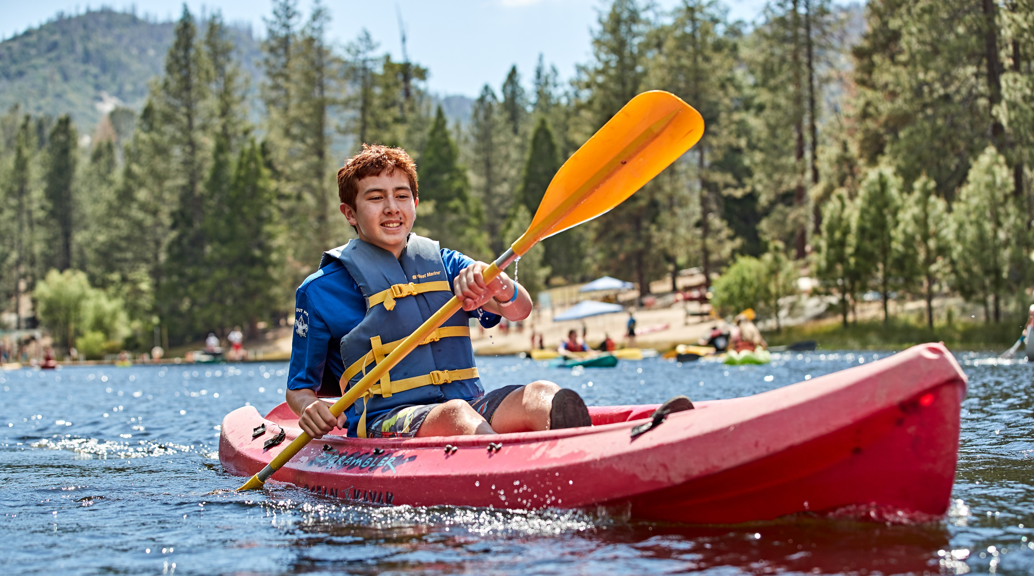
Thank you for joining us!
Questions after the webinar? Email ehiser.bsa@gmail.com
​
Notes:
Andrea

